Slide 1
Wireshark Basics

Slide 2
What is Wireshark?
Wireshark is an open-source packet analyzer, which is used for education, analysis, software development, communication protocol development, and network troubleshooting.
Notes:
2

Slide 3
Features of Wireshark
It is multi-platform software, i.e., it can run on Linux, Windows, OS X, FreeBSD, NetBSD, etc.
It performs deep inspection of the hundreds of protocols.
It often involves live analysis, i.e., from the different types of the network like the Ethernet, loopback, etc., we can read live data.
Various settings, like timers and filters, can be used to filter the output.
Notes:
3

Slide 4
Uses of Wireshark:
It is used by network security engineers to examine security problems.
It allows the users to watch all the traffic being passed over the network.
It can also analyze dropped packets.
It helps us to know how all the devices like laptop, mobile phones, desktop, switch, routers, etc., communicate in a local network or the rest of the world.
Notes:
4

Slide 5
Installation
For Windows :
Open the web browser.
Search for 'Download Wireshark.'
Select the Windows installer according to your system configuration, either 32-bt or 64-bit. Save the program and close the browser.
Now, open the software, and follow the install instruction by accepting the license.
The Wireshark is ready for use.

Slide 6
Installation
For Linux :
Go through this link
https://www.geeksforgeeks.org/how-to-install-and-use-wireshark-on-ubuntu-linux

Slide 7
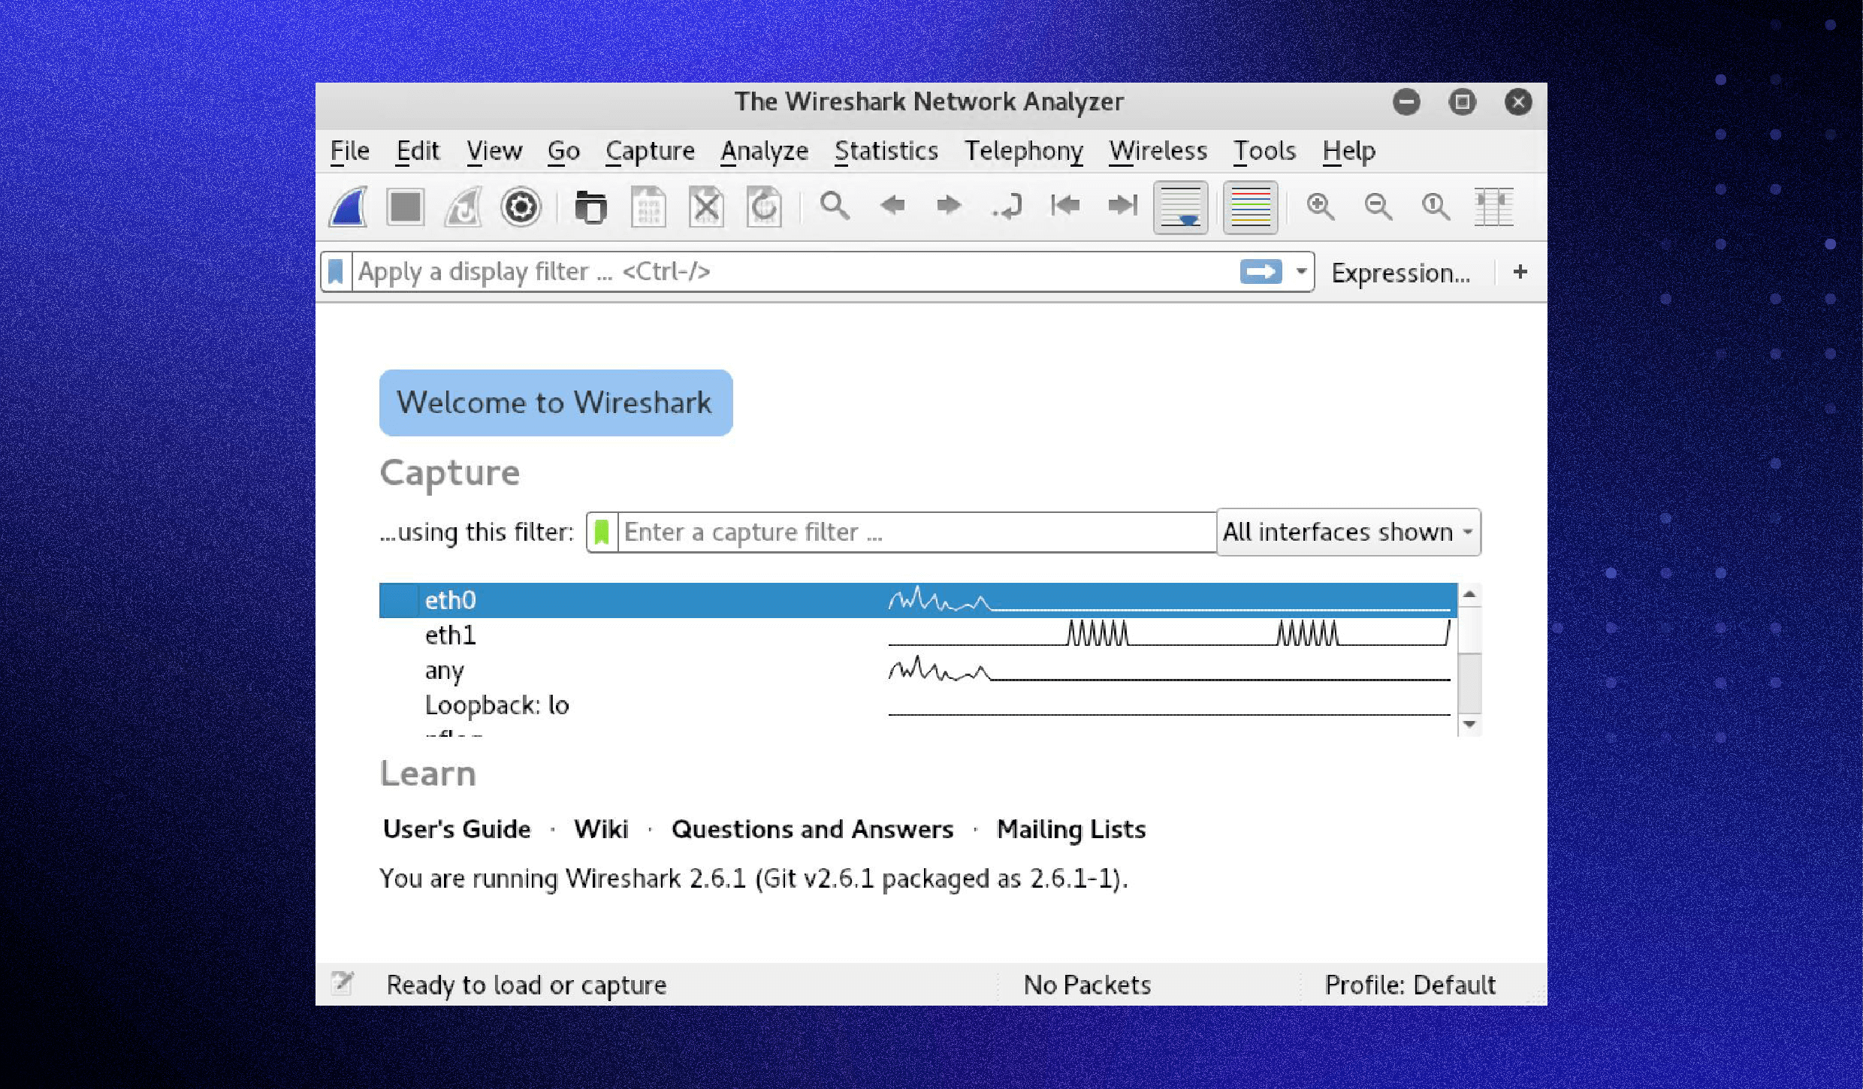
Capturing data packets on Wireshark
When you open Wireshark, you see a screen showing you a list of all the network connections you can monitor.
Notes:
7

Slide 8
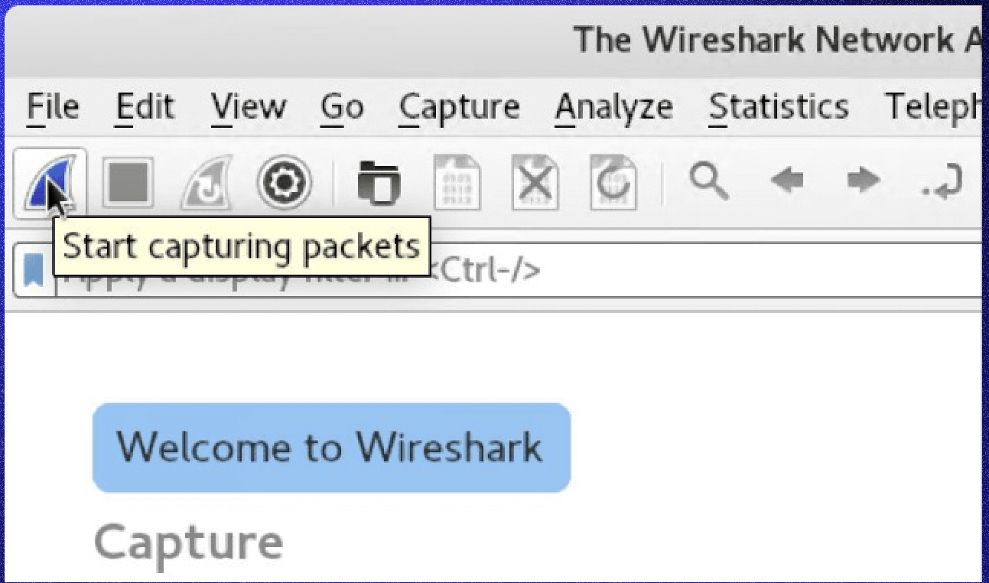
You can select one or more of the network interfaces using shift+left-click.
Now, click the first button on the toolbar, titled “Start capturing packets”
Notes:
8

Slide 9
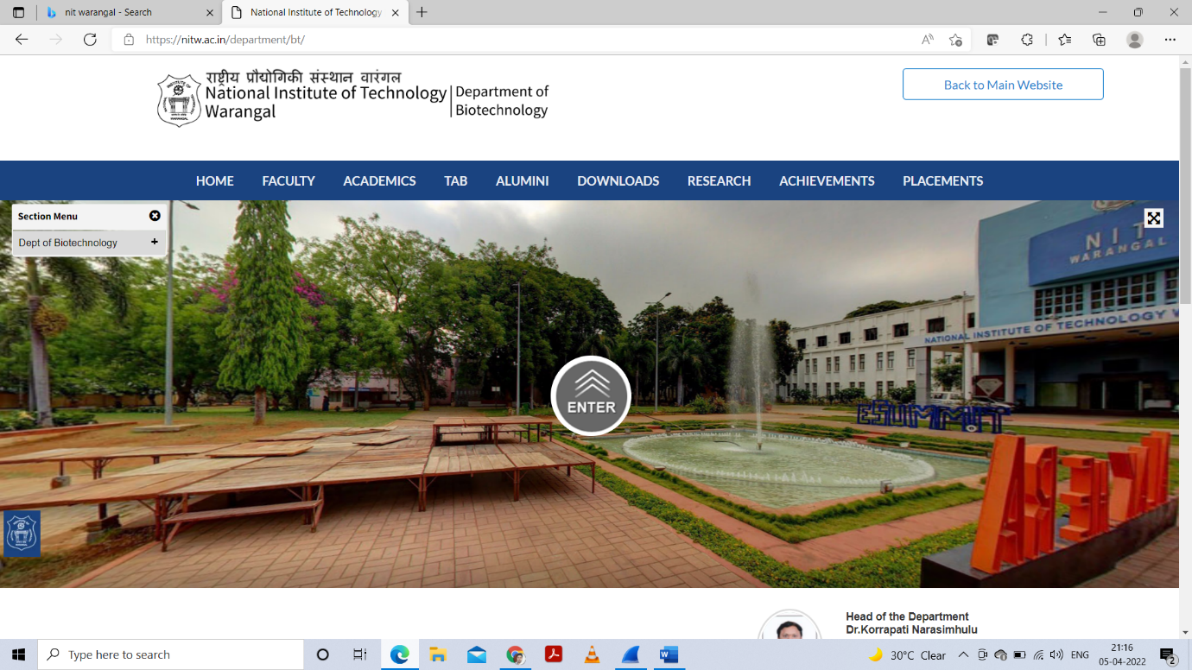
Example
Visiting National Institute of Technology, Warangal (nitw.ac.in) website.
Notes:
9

Slide 10
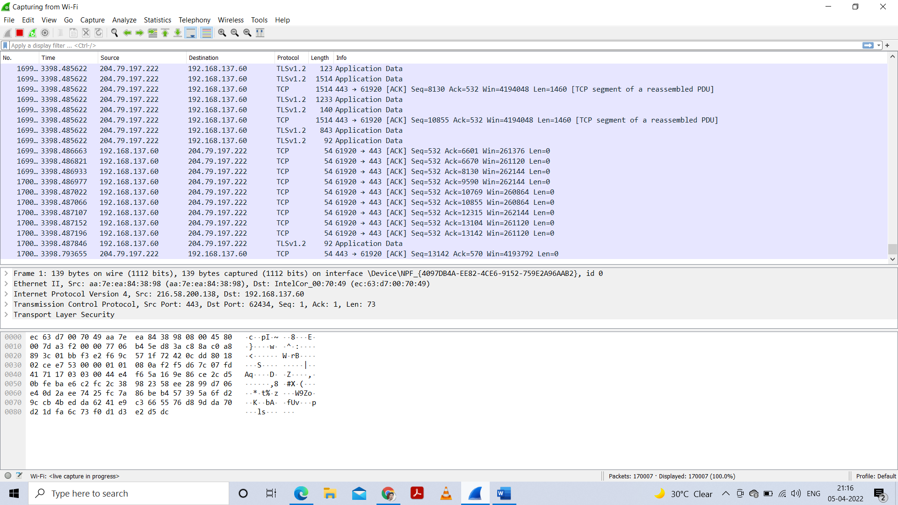
Example cont…
During the capture, Wireshark will show you the packets captured in real-time.
Notes:
10

Slide 11
Analyzing data packets on Wireshark (Top Pane)
No.: This is the number order of the packet captured. The bracket indicates that this packet is part of a conversation.
Time: Info: This column shows you more information about the packet contents, which will vary depending on the type of packet.This column shows how long after you started the capture this particular packet was captured. You can change this value in the Settings menu to display a different option.
Notes:
11

Slide 12
Continued...
Source: This is the address of the system that sent the packet.
Destination: This is the address of the packet destination.
Protocol: This is the type of packet. For example: TCP, DNS, DHCPv6, or ARP.
Length: This column shows you the packet’s length, measured in bytes.
Info: This column shows you more information about the packet contents, which will vary depending on the type of packet.
Notes:
12

Slide 13
Analyzing data packets on Wireshark (Middle Pane)
It shows you as much readable information about the packet as possible, depending on the packet type. You can right-click and create filters based on the highlighted text in this field.
Notes:
13

Slide 14
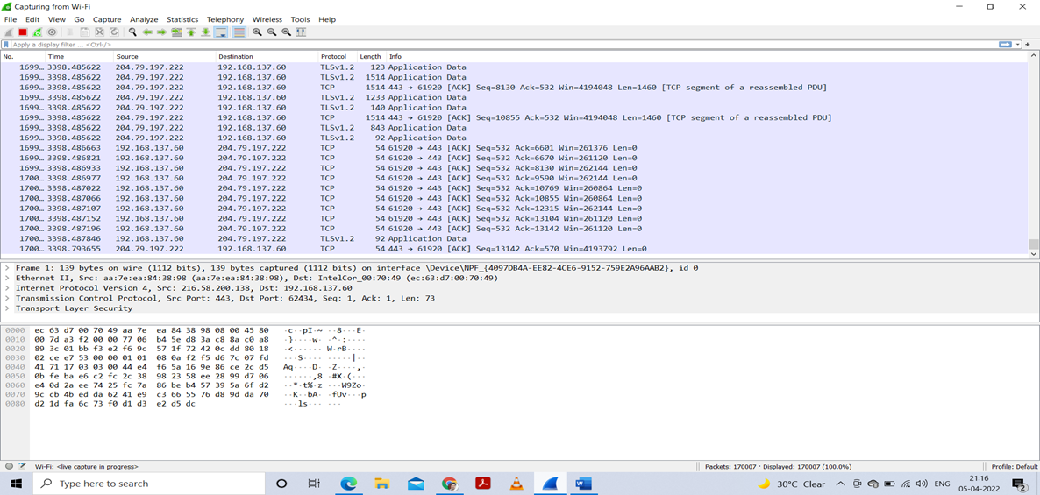
Analyzing data packets on Wireshark (Bottom Pane)
This shows Packet Bytes, displays the packet exactly as it was captured in hexadecimal.
Notes:
14

Slide 15
Wireshark filters
Filters allow you to view the capture the way you need to see it to troubleshoot the issues at hand.
Some of the best features of Wireshark are the capture filters and display filters.
Notes:
15

Slide 16
Wireshark capture filters
Capture filters limit the captured packets by the chosen filter. If the packets don’t match the filter, Wireshark won’t save them.
Examples of capture filters includes:
host IP-address: This filter limits the captured traffic to and from the IP address
net 192.168.0.0/24: This filter captures all traffic on the subnet
dst host IP-address: Capture packets sent to the specified host
port 53: Capture traffic on port 53 only
port not 53 and not arp: Capture all traffic except DNS and ARP traffic
Notes:
16

Slide 17
Wireshark display filters
After you’ve stopped the packet capture, use display filters to narrow down the packets in the Packet List to troubleshoot your issue.
One of the most useful display filters is:
ip.src==IP-address and ip.dst==IP-address
Above filter shows packets sent from one computer (ip.src) to another (ip.dst).
Notes:
17

Slide 18
Additional Wireshark features
Wireshark colorization options
Wireshark promiscuous mode
Wireshark command line
Metrics and statistics
Notes:
18

Slide 19
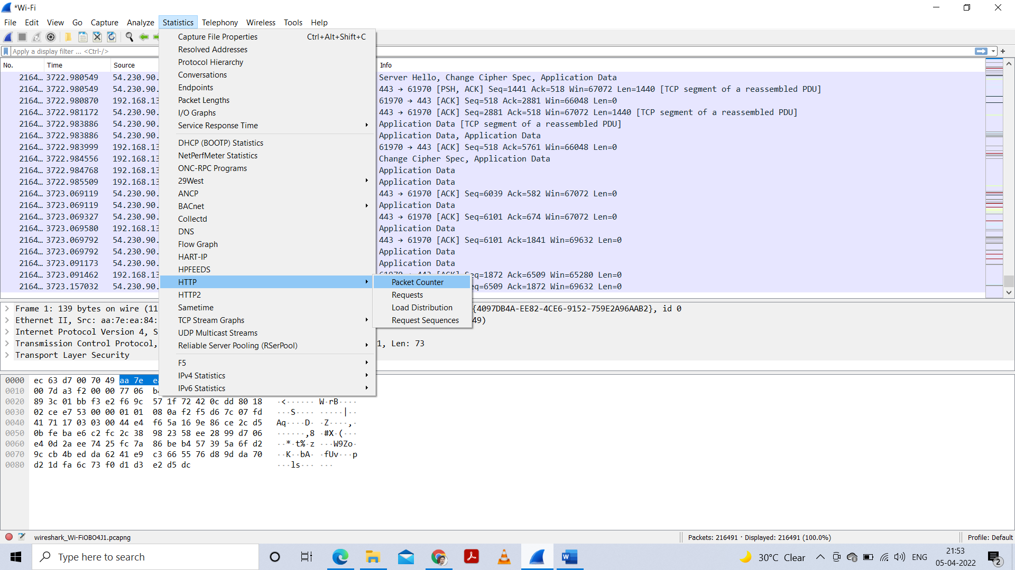
Applying some filters
1. Packet Counter :
Notes:
19

Slide 20
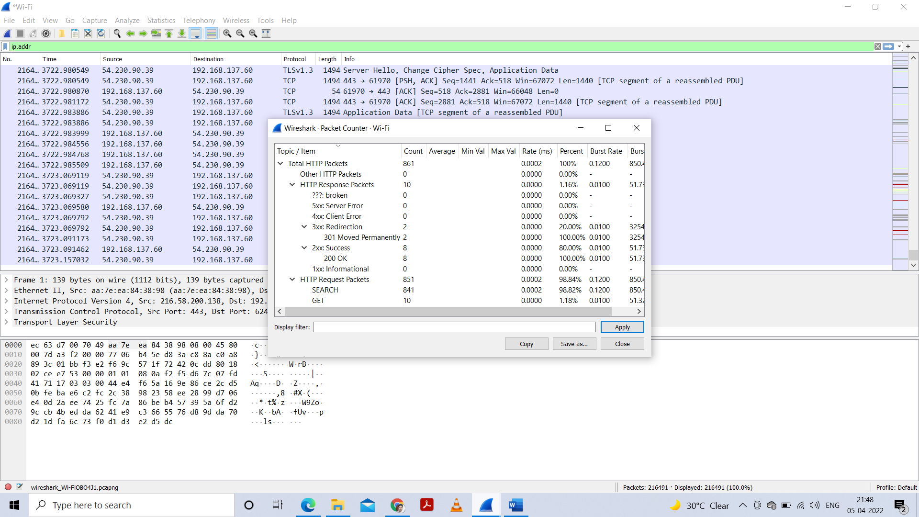
Cont…
Notes:
20

Slide 21
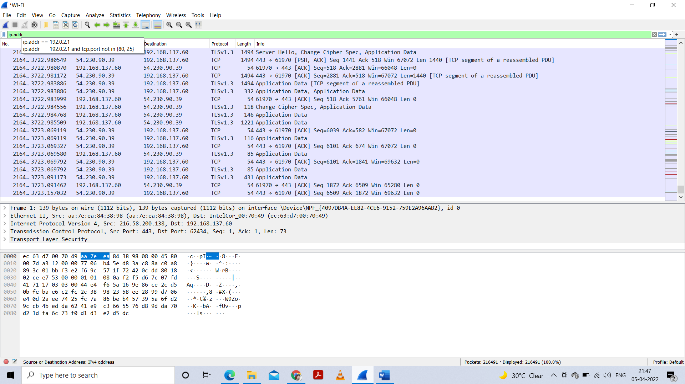
Cont…
Notes:
21

Slide 22
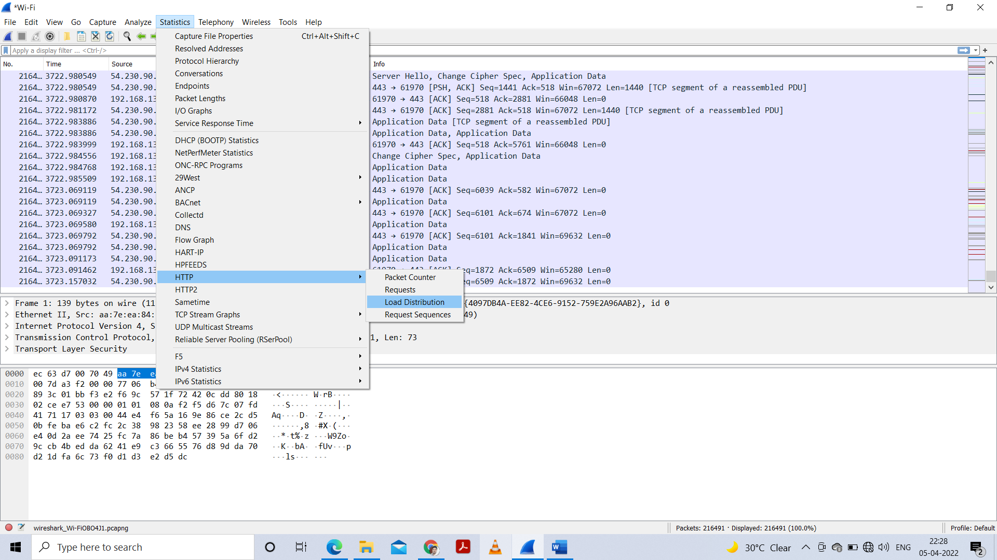
Applying some filters
2. Load distribution :
Notes:
22

Slide 23
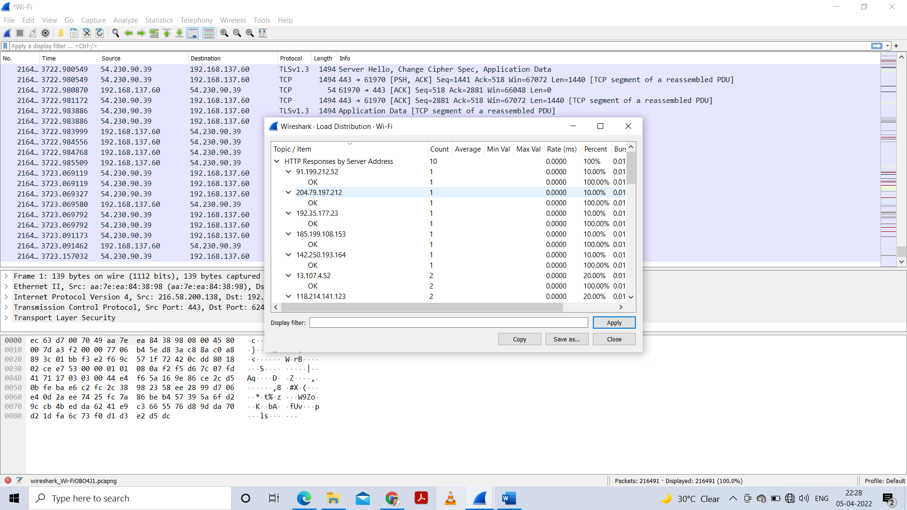
Cont…
Notes:
23

Slide 24
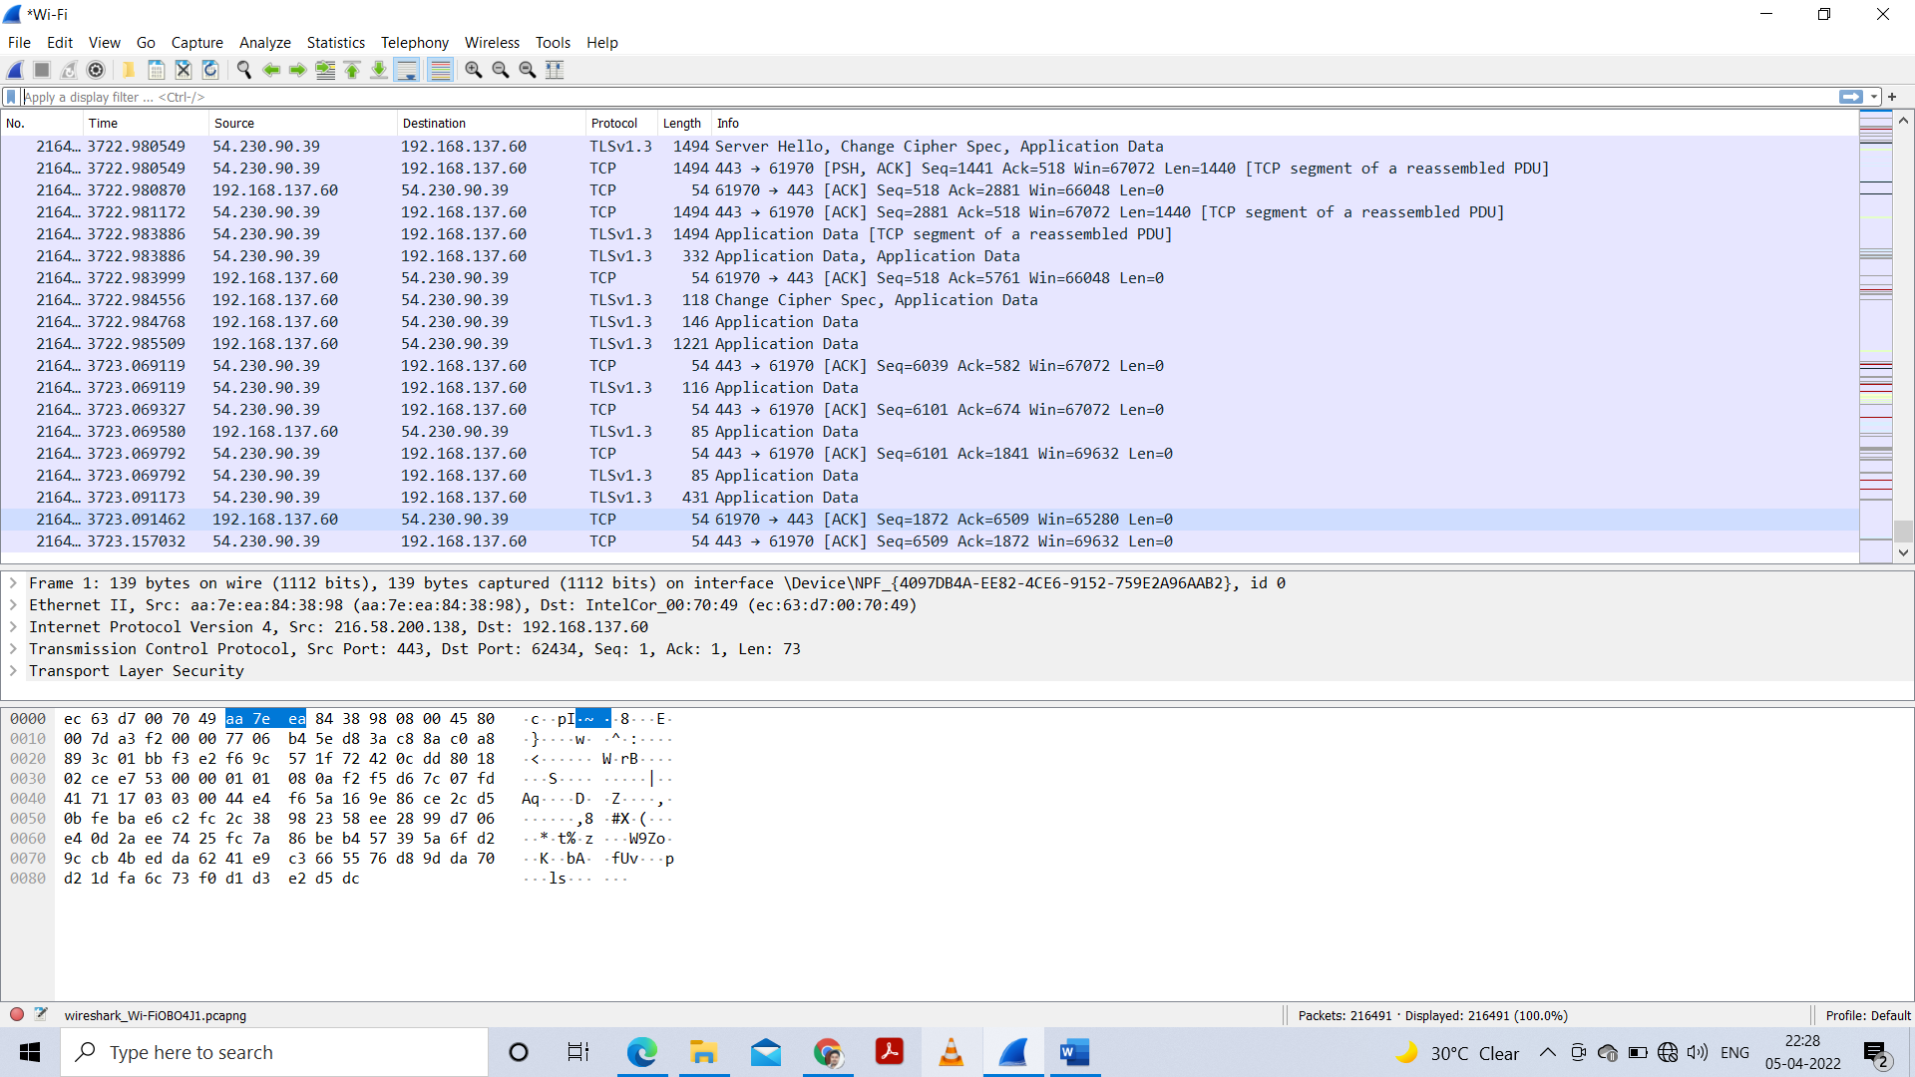
Cont…
Notes:
24

Slide 25



